Slide 1
Resume Classification
Group - 4
Papu Maharana | Saswata Bhattacharyya | Sharvin Ganesh | Manu Pranav Mk | Shreyas V Nandakarni

Slide 2
Contents:
INTRODUCTION
OBJECTIVE
DATA EXTRACTION
EXPLORATORY DATA ANALYSIS
MODEL BUILDING
MODEL DEPLOYMENT
CONCLUSION

Slide 3
Introduction:
In today’s fast-paced recruitment process, organizations receive a large number of resumes for limited positions.
To streamline candidate screening, we present a machine learning-based approach for automated resume classification.
Our project focuses on categorizing resumes into predefined job roles reducing manual effort and improving hiring efficiency.

Slide 4
Objective:
To develop a robust, accurate, and scalable machine learning model that classifies resumes based on job roles, skills, and qualifications.
Key features:
Text pre-processing of resumes to extract relevant information.
Implementation of Natural Language Processing (NLP) techniques for feature extraction.
Training machine learning classifiers to categorize resumes.
Use of metrics like accuracy, precision, and recall for performance evaluation.

Slide 5
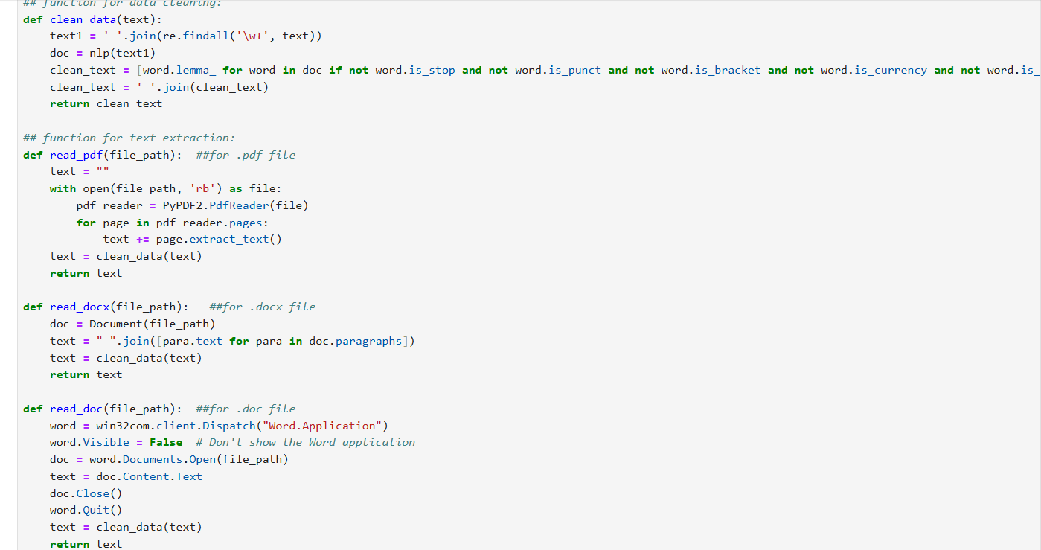
Data Extraction:
Extract and cleaning data from resume files using some python libraries:
Python-docx
PyPDF2
Win32com
NLP for data cleaning.

Slide 6
EDA:
Analyzing different job roles.
No missing and duplicate values in any column.
Visualizing top repeated words in resumes and showing how many resumes having same category.
Transferring texts into numerical using TFIDF transformer.
Applying SMOTE for imbalanced dataset to balanced.

Slide 7
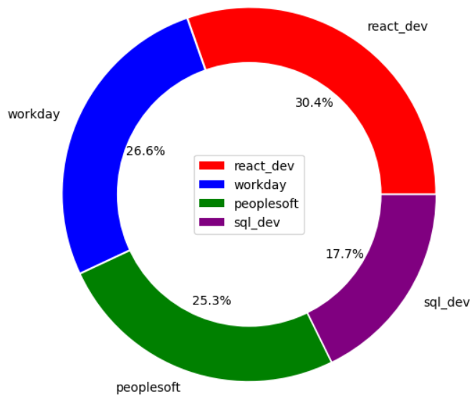
Visualization:
Different job roles

Slide 8
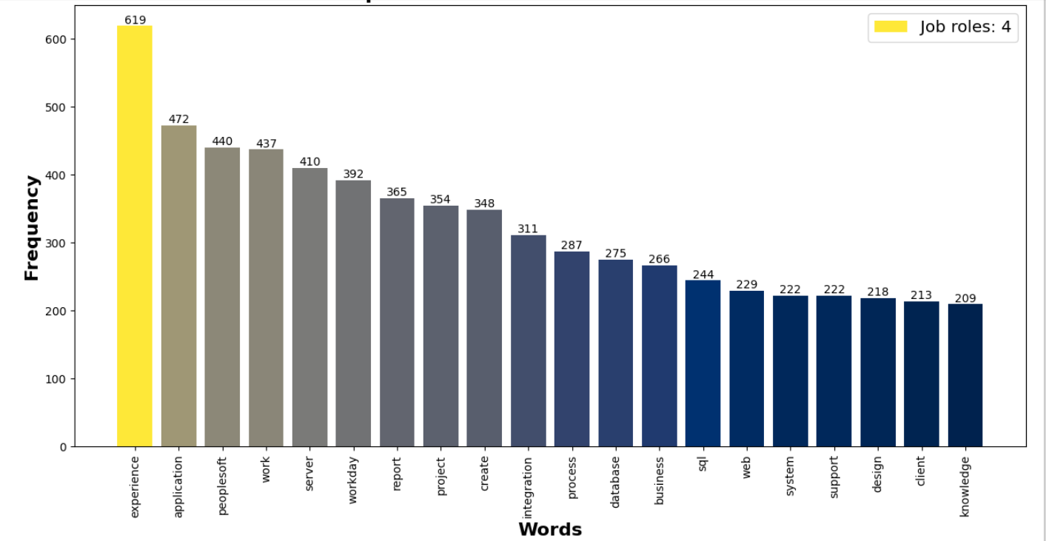
Top 20 most used words

Slide 9
Model Building:
Choosing cleaned prepared csv.
Split the data into training and testing set.
Building different models and train the model using training set.
Make prediction using test sets.
Evaluate the model performance.
Choosing best model by there training and testing accuracy.

Slide 10
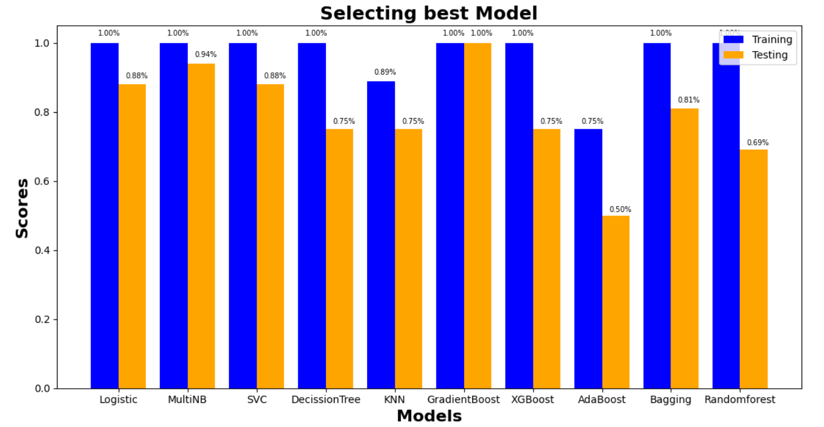
Visualization:

Slide 11
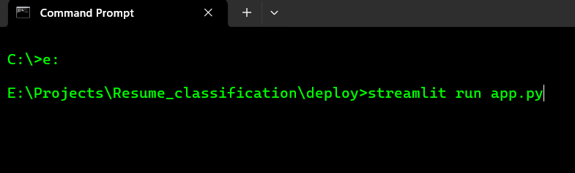
Model deployment:
Deploying on Streamlit :
Steps :
Open the command prompt where the files (pickle and deploy file) are located.
Run a command – “streamlit run file_name”.
Ex :

Slide 12
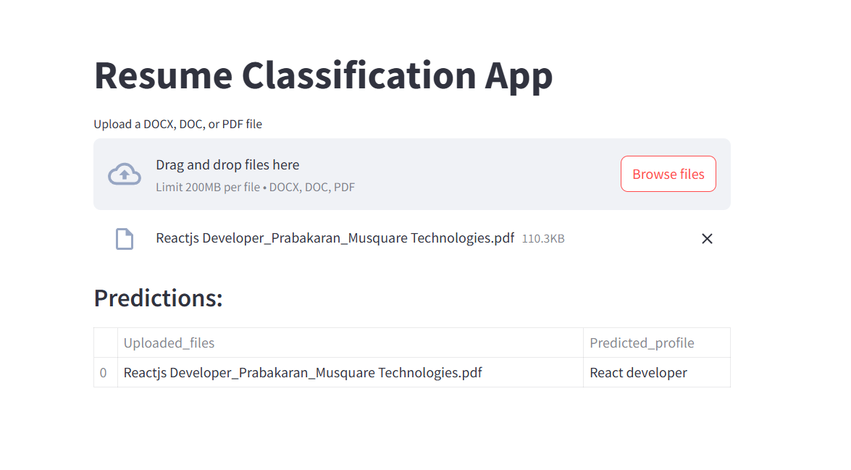
App preview:

Slide 13
Conclusion:
Our Resume Classification project demonstrates the potential of machine learning in automating HR processes. By leveraging Natural Language Processing (NLP) and advanced classification algorithms, we successfully developed a system that categorizes resumes efficiently and accurately.
Outcomes:
Reduced manual effort and time in resume screening.
Improved classification accuracy through data preprocessing and model optimization.
Scalability to handle a large volume of resumes.

Slide 14

Thank You

